Slide 1


Welcome!

Slide 2
PSYC 334: Research Methods in Psychology
Topic 3:
Non-experimental Research Methods
Prof. Kwaku Oppong Asante
Email: koppongasante@ug.edu.gh
Dr. Emmanuel Nii-Boye Quarshie
Email: enquarshie@ug.edu.gh

Slide 3

Do you remember PSYC 224...?
Research Designs
Experimental
PSYC 224
Non-experimental
Notes:
The experimental method involves direct manipulation and control of variables. The researcher manipulates the first variable of interest and then observes the response.
With the non-experimental method, relationships are studied by observing or otherwise measuring the variables of interest. Using this approach may include asking people to describe their behaviour, directly observing behaviour, recording physiological responses, or examining various public records such as census data.

Slide 4

But why non-experimental research?
Notes:
Non-experimental designs are the most heterogeneous category of the 2 classification categories (experimental [quasi-experimental], and non-experimental).
Commonly, non-experimental studies are purely observational and the results intended to be purely descriptive.
Most non-experimental designs are retrospective in nature and are sometimes called “ex post facto” (after the fact) research. Because a retrospective study is examining activities that have already occurred, manipulation of independent variables and randomisation are not possible.

Slide 5
Research Designs in Psychology
Experimental
(Quantitative)
Experimental Designs
Quasi Experimental Designs
PSYC 224
Quantitative (Observational)
Research
Designs
Non-experimental
Qualitative
Mixed Methods
Notes:
The experimental method involves direct manipulation and control of variables. The researcher manipulates the first variable of interest and then observes the response.
With the non-experimental method, relationships are studied by observing or otherwise measuring the variables of interest. Using this approach may include asking people to describe their behaviour, directly observing behaviour, recording physiological responses, or examining various public records such as census data.
Non-experimental methods, are also described as Non-manipulation studies.

Slide 6
Research Designs in Psychology
Experimental
(Quantitative)
Experimental Designs
Quasi Experimental Designs
PSYC 224
Quantitative (Observational)
Survey / Cross-sectional Studies
Case control Studies.
Cohort Studies (Longitudinal)
Research
Designs
Non-experimental
Qualitative
Mixed Methods

Slide 7
Quantitative: Observational Studies
With quantitative research, the data are collected and presented in the form of numbers - average scores for different groups on some task, percentages of people who do one thing or another, graphs and tables of data, and so on.
In an Observational Study, the researcher can only observe the effect of the exposure on the study subjects; he or she plays no role in assigning exposure to the study subjects.
Three main types of Observational Studies:
Survey / Cross-sectional Studies / Correlational Studies.
Case Control Studies.
Cohort Studies.
Notes:
Most research in psychology is quantitative in nature.

Slide 8
Quantitative: Observational Studies [conti…]
1]. Surveys

Slide 9
What is survey research?
Types of survey designs
Survey instruments
Question construction problems
Guidelines for Questionnaire Construction
Types of scales
Ensuring that questionnaire is easy
Pilot testing
Planning and conducting a mailed questionnaire survey
Planning and designing an interview survey
Strengths and Weaknesses of Survey Research
Lecture Outline

Slide 10
What is a survey research?
Survey research is based on the simple idea that if you want to find out what people think about some topic, you just ask them.
Survey research designs are procedures in quantitative research in which investigators administer a structured set of questions or statements to a group of people in order to describe the attitudes, opinions, behaviors, characteristics of the population, or prevalence of a condition.
Survey research focuses on developing an accurate description of the attitudes, beliefs, behaviour tendencies, or values of a specifically defined group of people.

Slide 12


Slide 13
When do you use a survey? (conti…)
Study of individuals’ attitudes, activities, opinions, and beliefs.
Assess changes in attitudes and beliefs over time.
Study relationship among variables
Assess prevalence and trends
Follow-up analyses
Evaluations

Slide 14
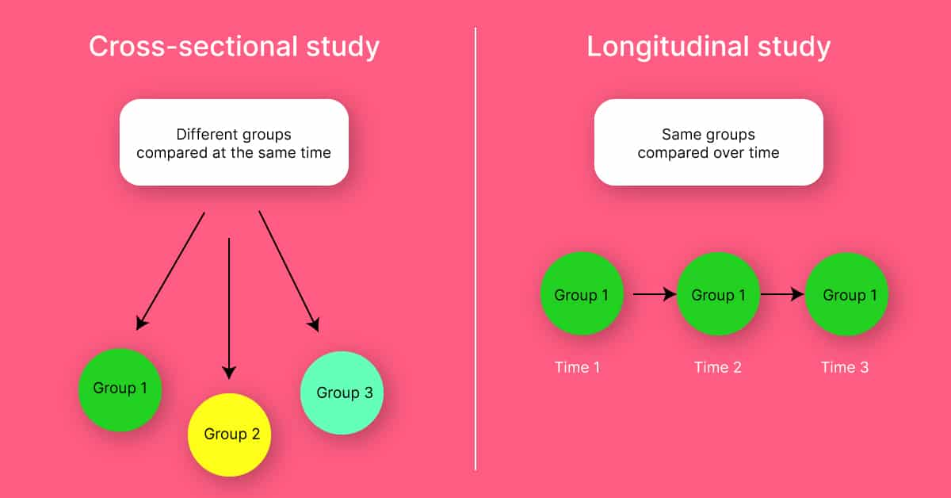
What are the types of survey designs?
(Study at One Point in Time)
(Study Over Time)
Notes:
With regard to time, there are two main types of surveys: cross-sectional and longitudinal.
Cross-sectional surveys are those that are administered at just one point in time. These surveys offer researchers a sort of snapshot in time, and give you an idea about how things are for your respondents at the particular point in time that the survey is administered. One problem with cross-sectional surveys is that the events, opinions, behaviours, and other phenomena that such surveys are designed to assess do not generally remain stagnant. Therefore, generalizing from a cross-sectional survey can be tricky; perhaps you can say something about the way things were in the moment that you administered your survey, but it is difficult to know whether things remained that way for long afterwards. Cross-sectional surveys have many important uses; however, researchers must remember what they have captured by administering a cross-sectional survey: a snapshot of life at the time the survey was administered.
One way to overcome this occasional problematic aspect of cross-sectional surveys is to administer a longitudinal survey. Longitudinal surveys enable a researcher to make observations over some extended period of time. There are several types of longitudinal surveys, including trend, panel, and cohort surveys.

Slide 15
What are the types of survey designs?
Time of Data Collection
Study Over Time
Study at One Point in Time
Longitudinal
Cross-sectional
Changes in a
sub-population
group identified
by a common
characteristic
over time
Trends in
the same
population
over time
Changes in the
Same people
over time
Knowledge,
Attitudes
and
Practices
Community
Needs
Assessment
Programme
Evaluation
Prevalence
Group
Comparisons
National
Assessment
Trend
Cohort
Panel

Slide 16
Forms of data collection based on who completes or records the data
Who Completes or Records the Data?
Participant
Researcher
Mailed
Questionnaire
Group-
administered
questionnaire
Electronic
Questionnaire
One-on-One
Over Telephone
Individual
Interview
Telephone
Interview

Slide 17
Survey instruments
A researcher may use already validated survey instruments (questionnaires), where they are available.
This is often recommended.
In this case the instrument needs to be evaluated for appropriateness:
Determine what sample was used to validate the instrument and examine the reliability and validity data across these samples
Evaluate the instrument based on recommended guidelines for questionnaire construction.
It becomes necessary to construct a new survey instrument if already available instruments are neither available nor appropriate.

Slide 18
Question construction problems
Question is unclear
Multiple questions
Question is wordy
Question is negatively worded
Overlapping responses
Unbalanced response options
Mismatch between questions and answers
Question includes overly technical language
Not all questions are applicable to all the participants

Slide 19
Items should match research objectives
Items must be appropriate for the respondents to be surveyed
Write short, simple questions
Avoid leading questions
Avoid double negatives
Avoid double-barred questions
Determine whether closed-ended or open-ended questions are needed
Construct mutually exclusive and exhaustive response categories
Consider different types of closed-ended response categories
Use multiple items to measure complex or abstract constructs
Guidelines for Questionnaire Construction

Slide 20
1]. Items should match research objectives
Survey items must cover all aspects of the research question.
An extensive review of the literature would help in identifying key areas that need to be covered.
Pay attention to issues of content and construct validity.

Slide 21
2]. Items must be appropriate for the respondents to be surveyed
Consider how participants will view and respond to your question.
Think about the literacy level, demographic and cultural characteristics of target participants.
Language should be familiar and clear to both participants and the researcher.
Avoid using technical language.

Slide 22
3]. Write short, simple questions
Questionnaire items should be short, clear, and precise.
Use simple language and avoid jargons
Ensure that participants can easily understand the items and interpret what the items address in the same way.
Avoid ambiguous questions or items
ambiguous questions leads the participants to interpret a lot of different possibilities?
E.g., “Where do you like to shop?”

Slide 23
4]. Avoid leading questions
A leading question is one that suggest how the participants should answer.
“Do you believe that you should keep more of your hard-earned money or that the government should get more of your money for increasing bureaucratic government programmes?”
Notes:
Why is this a leading question? Watchwords are: “hard-earned money”; bureaucratic”

Slide 24
5]. Avoid double negatives
A double negative is a sentence construction that contains two negatives.
E.g., “I do not think that psychology professors should not be allowed to conduct research during their office hours.”

Slide 25
6]. Avoid double-barred questions
Asking about two or more issues in a single question
“Do you agree that President Akufo-Addo should focus his attention on the economy and free education?”
This question asks about two separate issues: the economy and free education

Slide 26
7]. Determine whether closed-ended or open-ended questions are needed.
Open-ended questions require participants to supply their own answer
Closed-ended questions require respondents to choose from a set of predetermined response alternatives.
What do you do when you feel depressed?
Eat
Sleep
Exercise
Talk to a friend
Cry
Other (specify)……….
Notes:
It’s also possible to have a mixed question format. E.g. adding “Other” (specify)

Slide 27
8]. Construct mutually exclusive and exhaustive response categories
Please check the box that includes your age
18-30 □
30-40 □
40-50 □
50-60 □
Do you see the problem?
The responses are not mutually exclusive.
It is also not exhaustive because no option is provided for respondents outside these age categories.
Should look like this:
17 or younger □
18 - 30 □
31 - 40 □
41 - 50 □
51 - 60 □
61 or older □

Slide 28
9]. Consider different types of closed-ended response categories
Rating scales
An ordered set of response choice, such as a 5-point rating scale measuring the direction and strength of attitude.
May be dichotomous as in:
E.g. I take a positive look toward myself
[1] Yes [2] No
May also be multichotomous:
E.g. I take a positive look at myself
[1] strongly disagree [2] disagree [3] Neutral [4] Agree [5] strongly agree
Notes:
The 5-point scale is superior to the dichotomous format because it taps into two things: direction and strength of attitude.

Slide 29
9]. Consider different types of closed-ended response categories (conti…)
Binary Forced Choice
Participants must select from the two response choices provided with an item.
1]. A. I have a natural talent for influencing people.
B. I am not good at influencing people.
2]. A. I would do almost anything on a dare.
B. I tend to be a fairly cautious person.

Slide 30
9]. Consider different types of closed-ended response categories (conti…)
Ranking
Participants are asked to put their responses in ascending or descending order
The following are five newspapers in Ghana. Please fill in your rank order of these newspapers, where 1 is the most credible newspaper and 5 is the least credible
___ Daily Graphic
___ Dispatch
___ Daily Guide
___ The Statesman
___ The Ghanaian Chronicle

Slide 31
9]. Consider different types of closed-ended response categories (conti…)
Checklists
Participants are asked to check all response categories that apply.
During the past 2 years, have you taken a course in any of the following subjects? Check all that apply.
Economics □
Psychology □
Social Work □
Sociology □
Political Science □
Geography □

Slide 32
10]. Use multiple items to measure complex or abstract constructs
A single item may be adequate to measure variables such sex, age, weight, etc.
However, a single item may not be adequate to measure complex constructs such as self-esteem, depression, intelligence, psychological well-being.
Most psychological constructs are best measured using multiple items (multi-item instruments).
Participants scores are determined based on the sum of responses across the various items – this is called scaling.

Slide 33
Types of scales
1]. Semantic differential scale
Scaling method measure the meanings participants give to attitudinal objects
Several contrasting adjective pairs are developed to address different dimensions of the attitudinal object.
Happy : Sad
Good : Bad

Slide 34
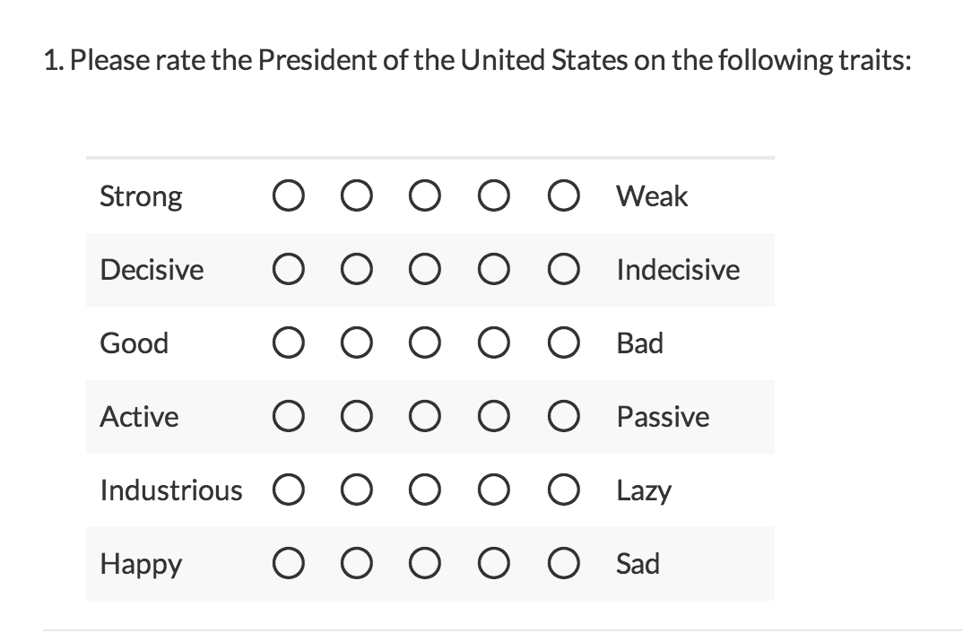
Semantic differential scale - example
Please rate the president of Ghana on the following scale:

Slide 35
Types of scales
2]. Likert scaling
The research uses a multi-item scale to measure a single construct by summing each participants’ responses to the items on the scale.
Also known as summated rating scale

Slide 36
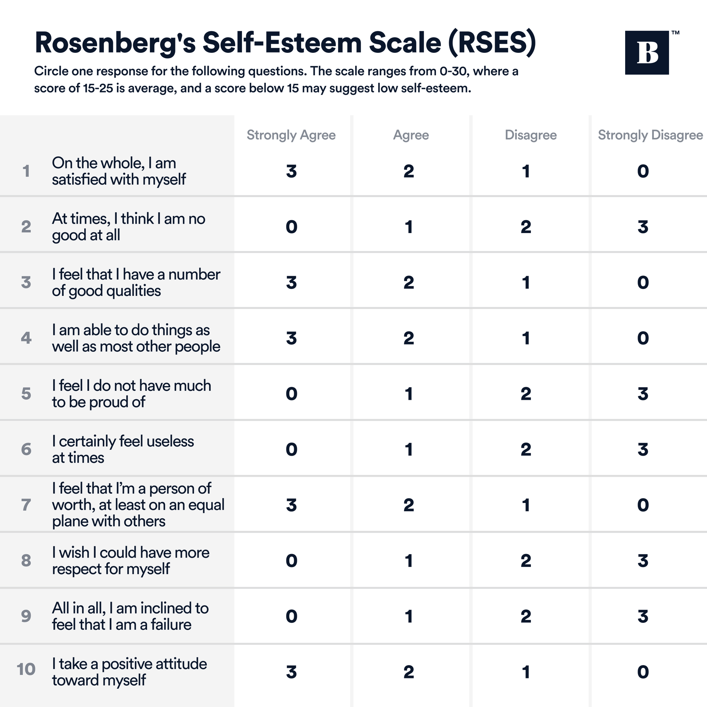
Likert scale - example

Slide 37
Ensure that questionnaire is easy to use from the beginning to the end.
Ordering of questions
Consider order and sequencing of questions.
It’s generally better to ask positive questions first.
Contingency questions
An item directing the participant to different follow-up questions depending on the initial response.
Question 10. What is your gender
Male --- If male, go to question 11.
Female --- If female, go to question 12.

Slide 38
Ensure that questionnaire is easy to use from the beginning to the end (conti…).
Questionnaire length
The questionnaire should not be too long.
Lengthy questionnaires can discourage participants.
Response bias:
Social desirability: Error that occurs when participants try to respond in the way they think makes them look good.
Response set: the tendency for participants to respond in a way to a set of items.

Slide 39
Pilot testing
Test on a small number of individuals in the sample.
Ask for written feedback on the questions.
Revise the survey based on the written comments.
Exclude the pilot participants from the final sample for the study.

Slide 40
Planning and conducting a mailed questionnaire survey
Write a cover letter to invite the participants to complete the questionnaire.
Form and construct the questionnaire.
Identify what statistical procedures will be used to analyse data from the mailed questionnaire.

Slide 41
Planning and designing an interview survey
The interviewer should maintain a neutral stance during the interview.
Train the interviewers prior to the interview.
Take good notes of responses or use a tape recorder.
For telephone interviews, develop a telephone interview guide prior to the interview

Slide 42
Strengths and Weaknesses of Survey Research
Strengths
Useful in describing characteristics of a large population
Make large sample feasible
Survey are not constrained by geographical boundaries
It’s less expensive
Weaknesses
Lack of manipulation of the independent variables
We cannot establish causality
Prone to respondent biases

Slide 43

FURTHER READING
Correlation Vs. Causation
Types/forms of correlation
Challenges association with correlational studies

Slide 44
Quantitative: Observational Studies [conti…]
2]. Case Control Study

Slide 45
There are two groups in a case-control study: one has a health issue (Case group), and this group is “matched” to a Control group without the health issue based on characteristics like age, gender, occupation.
In this study type, we can look back in the patient’s histories to look for exposure to risk factors that are common to the Case group, but not the Control group.

Slide 46
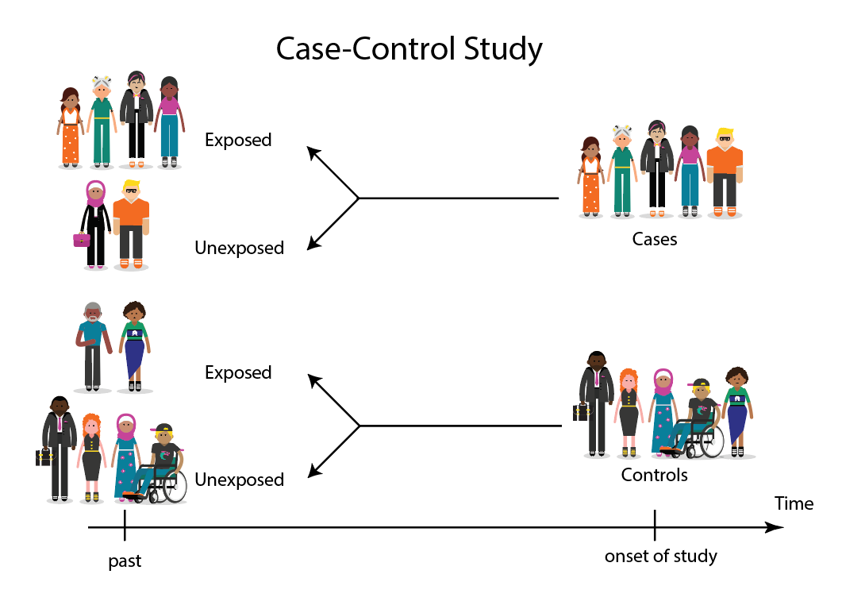
Notes:
This diagram represents taking both the case (disease) and the control (no disease) groups and looking back at their histories to determine their exposure to possible contributing factors.
The researchers then determine the likelihood of those factors contributing to the disease.
Steps:
Identify cases.
Select control, which may be matched to cases.
Measure exposure or risk factors of interest.
Compare the presence or absence of exposure in cases and control.

Slide 47
Advantages
Requires comparatively few subjects.
Multiple exposures or risk factors can be examined.
Limitations
Susceptible to recall bias or information bias.
Selection of an appropriate comparison group may be difficult.
Notes:
Advantages and limitations of Case Control Studies

Slide 48
FURTHER READING
Case-control studies:
Advantages.
Limitations.

Slide 49
Quantitative: Observational Studies [conti…]
3]. Cohort/Longitudinal Study

Slide 50
Cohort is a “group of people with defined characteristics who are followed up to determine incidence of, or mortality from, some specific disease, all causes of death, or some other outcome” (Morabia, 2004, pp.249-250).
Researchers measure exposure variables before the occurrence of outcomes and compare the disease incidence between the exposed and unexposed cohorts after an extended period of time.
Notes:
Often called “longitudinal studies” or “prospective studies”, researchers measure exposure variables before the occurrence of outcomes and compare the disease incidence between the exposed and unexposed cohorts after an extended period of time.

Slide 51
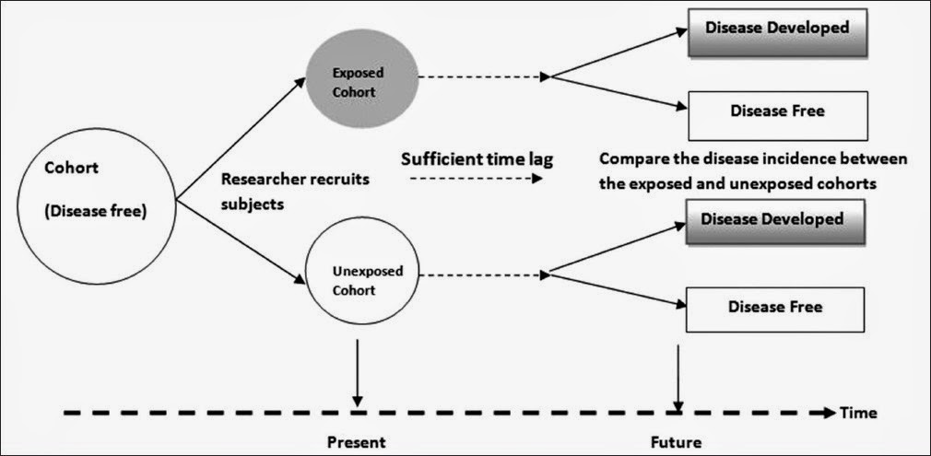
Schematic diagram of Cohort study design (Jose & Cotellessa, 2015)

Slide 52
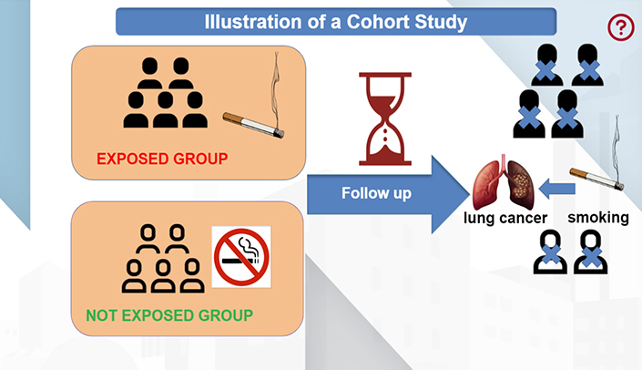

Slide 53
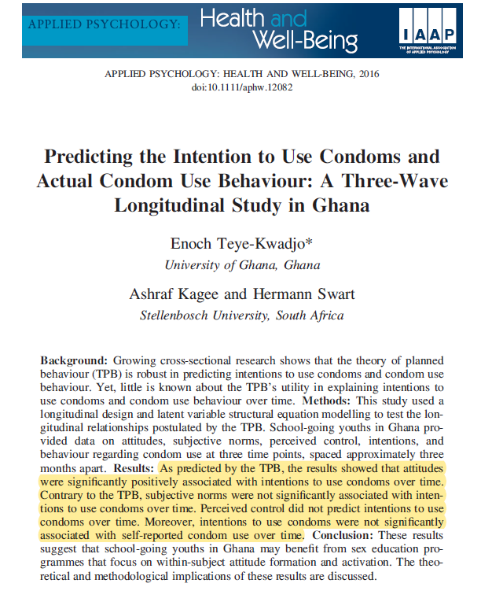

Slide 54
Advantages
Multiple diseases and conditions can be studied at the same time.
Gather data regarding sequence of events; can assess risk factors.
Limitations
Expensive and time consuming.
Susceptible to loss to follow-up or withdrawals.
Notes:
Advantages and limitations of Cohort studies

Slide 55
FURTHER READING
Cohort studies:
Advantages.
Limitations.

Slide 56

I thank you
for your attention
Questions?
Comments?
Concerns?
Announcements

